Slide 1

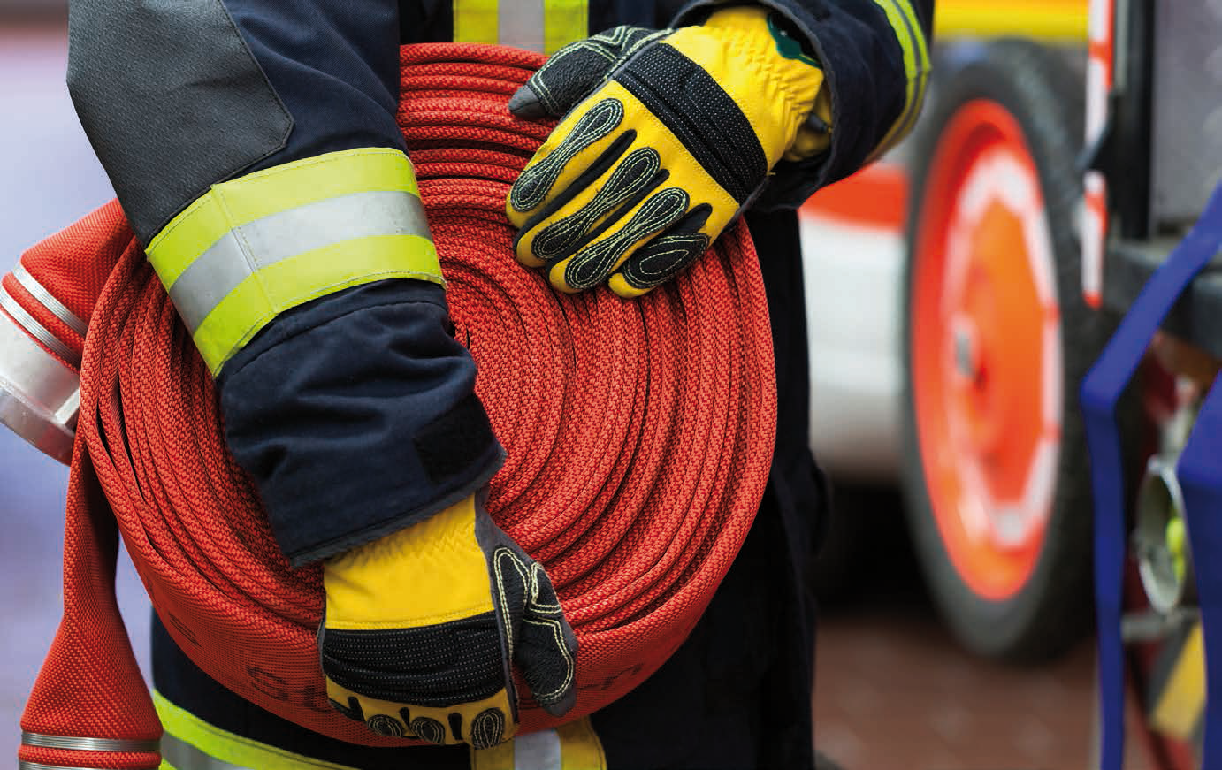
Influence of prior consumption of isotonic drinks
on the performance level of firemen
THESIS
Dr. Huygh
AIM OF THE STUDY
Compare the influence of pre-shift consumption of isotonic drinks versus water on physical and cognitive performance
METHODS
9 firemen randomized to a cross-over trial:
  without prior drinking
  after the prior drinking of water
  after the prior drinking of isotonic drinks
Parameters before the trial, immediately after the tests and after 60 minutes of rest:
  blood pressure, glycaemia and fluid and electrolyte balance
Physical and cognitive tests:
  plate tapping test, 10 x 5-meter shuttle run, hand grip test, bent arm hang, endurance test, and Symbol Digit Substitution Test
RESULTS
Significant differences were only found for:
  plate tapping (DAY 1 vs WATER); 10x5 meter shuttle run (DAY 1 vs ISOTONIC and DAY 1 vs WATER); glycaemia "immediately after"
  DAY 1 vs ISOTONIC; urine osmolality "after 60 minutes of rest" (DAY 1 vs ISOTONIC group)
CONCLUSION
No difference between the preliminary drinking of WATER vs ISOTONIC drinks
Risk of rebound hypoglycemia after ISOTONIC drinks
Studies with larger numbers of participants are needed

